Slide 1

CS1951 L
Blockchains & Cryptocurrencies
Fall 2025
Lecture 25
Byzantine Fault-Tolerant Consensus
Maurice Herlihy
Brown University

Slide 2



Consensus: Each Party has a Private Input

Slide 3
They Communicate

Slide 4
They Agree on One Party’s Input

Slide 5
Crash Failures

Slide 6
Crash Failures

Slide 7

Byzantine Failures

Slide 8




He said, She said …
???

Slide 9
He said, She said …
???

Slide 10
Identifying Input Values
sorry
f

Slide 11
Identifying Input Values
!
f+1

Slide 12
Byzantine Model
There are n validators

Slide 13
Byzantine Model
As many as f may be dishonest,
where f < n/3
(or f < n/2 with sigs)

Slide 14
Synchronous Model
known Δ
Notes:
In synchronous models, processes take steps at the same rate. After the red process takes a step, it knows the blue process has also taken a step.
Synchronous comes from Greek: syn = together, chronos = time.

Slide 15
Asynchronous Model
Notes:
In asynchronous models, processes take steps at any rate.
Asynchronous comes from Greek: a (not) + synchronous (at the same time).
Synchronous comes from Greek: syn = together, chronos = time.

Slide 16
Semi-Synchronous
known Δ
Notes:
In asynchronous models, processes take steps at any rate.
Asynchronous comes from Greek: a (not) + synchronous (at the same time).
Synchronous comes from Greek: syn = together, chronos = time.

Slide 17
Semi-Synchronous
Global Stabilization Time
(exactly when unknown)
Notes:
In asynchronous models, processes take steps at any rate.
Asynchronous comes from Greek: a (not) + synchronous (at the same time).
Synchronous comes from Greek: syn = together, chronos = time.

Slide 18
Adaptive Adversary
Adaptively decides which f to corrupt and when to corrupt them
Example: DoS attack
There are many kinds of adaptive adversaries …

Slide 19
Adaptive Adversary
How quickly can the adversary corrupt?
Same round, next round, polylog rounds ..
Rushing adversary can corrupt in round r but cannot suppress round-r messages
Strongly rushing adversary can suppress honest round-r messages

Slide 20
Static Adversary
Corrupts validators at start of protocol
Like a “mole” in a spy novel
Leader-based protocols assume static adversary
(or adaptive with slow corruption time)

Slide 21
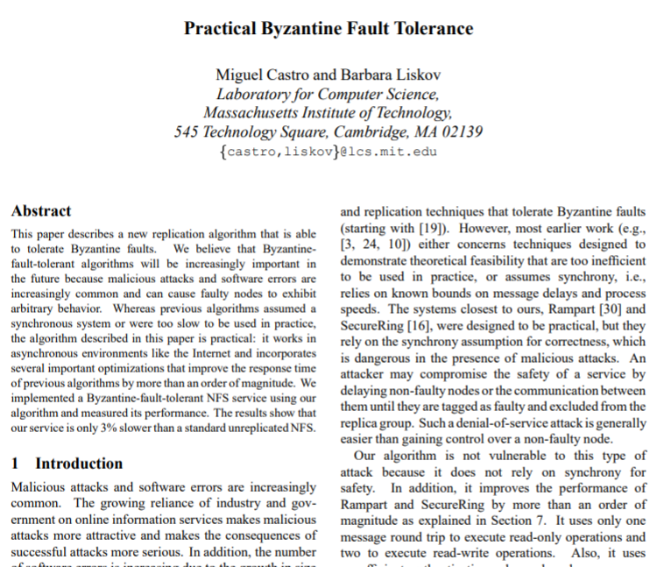
Practical Byzantine Fault-Tolerance
1st practical BFT agreement protocol (1999)
Many improvements, optimizations
Precedes blockchain
Semi-Synchronous model

Slide 22

Before PBFT
Byzantine fault-tolerance will be super-important!
You Theory losers disgust me, wasting your lives on BFT!
Mainstream
Systems Research
Distributed Computing

Slide 23
After PBFT
We just found out about blockchains: why didn’t you tell us BFT was important?
Um, …
Mainstream
Systems Research
Distributed Computing

Slide 24
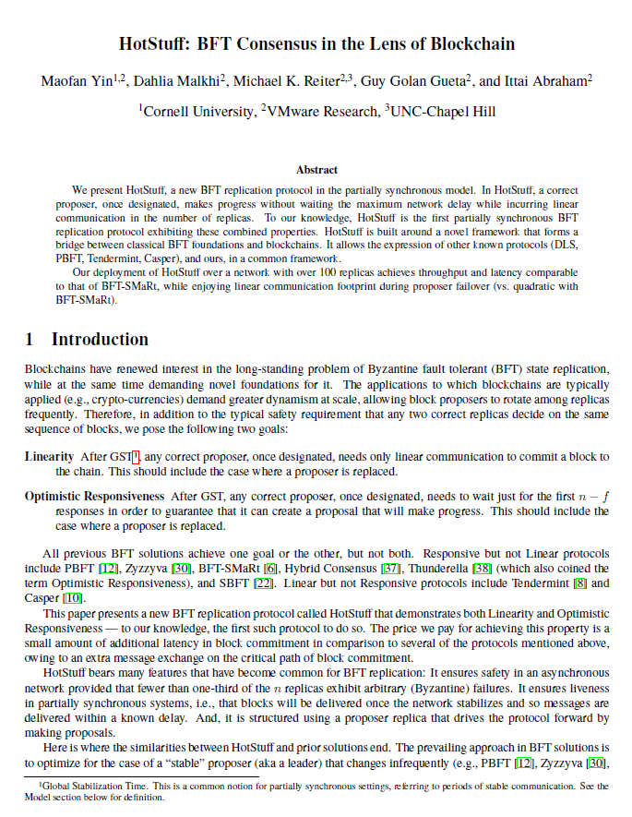
HotStuff
“Best of breed” improvement on PBFT
Less communication
Semi-Synchronous model

Slide 25
BFT vs PoW
Well-understood
Many protocols, research papers
Proofs and open-source implementations
Way faster than PoW
Decisions are final

Slide 26
BFT vs PoW
Requires node identities
Because Sybil attacks

Slide 27
Structure
Hello, I’m your leader
Hello, I’m an honest validator
Hello, I’m honest
Hello, I’m honest
I’m evil, LOL

Slide 28
Jargon Watch
Different papers, different terms, same thing
“proposer” == “leader”
“replica” == “validator”
Same paper sometimes inconsistent
But these mean the exact same thing

Slide 29
All messages signed by senders
All signatures checked by receivers
Omitted from protocols for brevity

Slide 30
PoW vs BFT
 | PoW | BFT
Identity | Don’t care | Care
Finality
Node scalability
Power
Adversary
Synchrony
Correctness Proof

Slide 31
PoW vs BFT
 | PoW | BFT
Identity | Don’t care | Care
Finality | No | Yes
Node scalability
Power Hungry?
Adversary
Synchrony
Correctness Proof

Slide 32
PoW vs BFT
 | PoW | BFT
Identity | Don’t care | Care
Finality | No | Yes
Node scalability | Excellent | Limited
Power Hungry? | Bad | Good
Adversary
Synchrony
Correctness Proof

Slide 33
PoW vs BFT
 | PoW | BFT
Identity | Don’t care | Care
Finality | No | Yes
Node scalability | Excellent | Limited
Power Hungry? | Bad | Good
Adversary | ~25% | 33%
Synchrony
Correctness Proof

Slide 34
PoW vs BFT
 | PoW | BFT
Identity | Don’t care | Care
Finality | No | Yes
Node scalability | Excellent | Limited
Power Hungry? | Bad | Good
Adversary | ~25% | 33%
Synchrony | Synchronous | Semi-Synchronous
Correctness Proof

Slide 35
PoW vs BFT
 | PoW | BFT
Identity | Don’t care | Care
Finality | No | Yes
Node scalability | Excellent | Limited
Power Hungry? | Bad | Good
Adversary | ~25% | 33%
Synchrony | Synchronous | Semi-Synchronous
Correctness Proof | Not Really | Yes

Slide 36
Block Party
Each block eventually:
Committed, or
block
Rejected
Goal is agreement on …
A growing chain of committed blocks

Slide 37
Parent Pointers
block
block
block
block
block
Transitive closure forms ancestors

Slide 38
Parent Pointers
block
block
block
block
height
k
height
k+1

Slide 39
Parent Pointers
Same branch
block
block
block
block
height
k
height
k+1

Slide 40
Parent Pointers
conflicting
(different branches)
block
block
block
block
height
k
height
k+1

Slide 41
Validators
Hello, I’m an honest validator
I only vote only once per height …
Always at increasing heights
If I vote on B, then I have seen B’s ancestors

Slide 42
Quorum Certificates
I vote for B!
whatever
Form a quorum certificate (QC) for B If 2f+1 votes collected,

Slide 43
Quorum Certificates
QC | B
QC | B’
QC | W
QC | W’
QC | W’’
Each block’s QC is for ancestor

Slide 44
QC Chains
1-chain:
2f+1 correct validators voted for B at B.height
QC | B
QC | B’

Slide 45
QC Chains
2-chain:
2f+1 correct validators voted for B’’ and received 1-chain B ← B’
1-chain:
2f+1 correct validators voted for B at B.height
QC | B
QC | B’
QC | B
QC | B’
QC | B’’

Slide 46
QC Chains
2-chain:
2f+1 correct validators voted for B’’ and received 1-chain B ← B’
1-chain:
2f+1 correct validators voted for B at B.height
3-chain:
2f+1 correct validators voted for B’’’ and received 2-chain B ← B’ ← B’’
QC | B
QC | B’
QC | B
QC | B’
QC | B’’
QC | B
QC | B’
QC | B’’
QC | B’’’

Slide 47
Committed Block
QC | B
QC | B’
QC | B’’
height
k
height
k+1
height
k+2
B is committed if there is a 3-chain
B ← B’ ← B’’,
where B parent of B’ parent of B’’

Slide 48
Validators
Hello, I’m an honest validator

Slide 49
Validators
And these are my blocks …
QC | B
QC | B’
QC | B’’

Slide 50
Validators
B’ ← B’’ is the highest 1-chain I’ve seen
QC | B
QC | B’
QC | B’’

Slide 51
Validators
So B is my preferred block
QC | B
QC | B’
QC | B’’

Slide 52
Validators
I will vote for B_{new} only if it has my preferred block as ancestor
QC | B
QC | B’
QC | B’’
QC | B_{new}

Slide 53
Only Two Kinds of Message
propose
vote

Slide 54
Only Two Kinds of Message
propose: B, B_{hqc}
vote: B, B_{hqc}
Highest QC seen by sender
Highest QC seen by sender

Slide 55
Propose Message
B_{hqc}: tail of highest 1-chain
vheight: height of last voted block
Hello, I’m an honest validator and this is my state

Slide 56
Validators
Hello, I’m the leader
B_{hqc}: tail of highest 1-chain
vheight: height of last voted block

Slide 57
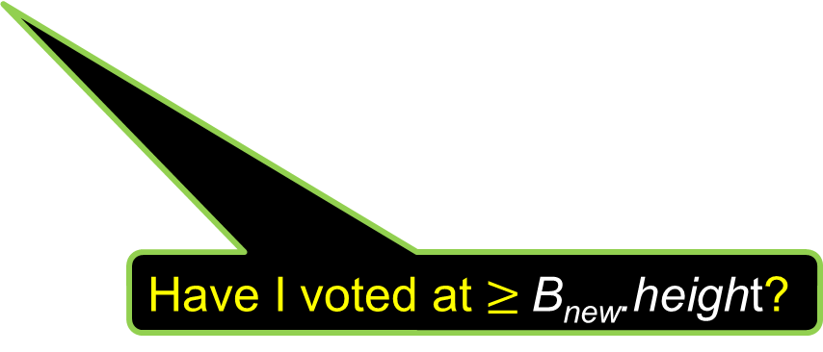
Propose Message
B_{hqc}: tail of highest 1-chain
vheight: height of last voted block
propose: B_{new}, B_{hqc}
Is my preferred block an ancestor of B_{new}?
Update B_{hqc}?
Have I voted at $≥$B_{new}.height?

Slide 58
Vote Message
B_{hqc}: tail of highest 1-chain
vheight: height of last voted block
vote: B_{new}, B_{hqc}
Send current B_{hqc}
Update my vheight
If new blocks now committed, execute their smart contracts in block order

Slide 59
Vote Message
vote: B_{new}, B_{hqc}
vote: B_{new}, B_{hqc}
vote: B_{new}, B_{hqc}
vote: B_{new}, B_{hqc}
Collect votes for B_{new} until I can form a QC

Slide 60
Pacemaker
Picking a leader
Round-robin
What to propose?
Get QCs from 2f+1 replicas
Extend from latest QC

Slide 61
See Paper for Full Spec
https://arxiv.org/pdf/1803.05069.pdf

Slide 62
Blockchains vs BlockDAGs

Slide 63
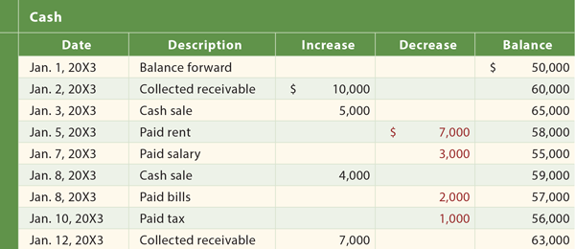
A Blockchain is just a distributed ledger
Notes:
A blockchain is just one way to implement a distributed ledger. Ledgers were invented by Italian renaissance bankers to keep track of their assets. A Ledger is just a list of things that happened. The list is append-only: once you write an entry, you cannot go back to delete or modify it. If you make a mistake, you can append a correction, but you cannot cover up the past. We usually think of ledgers as recording financial data, but a ledger could hold anything: a database log, a ship’s log, or a list of today’s visitors. The important thing is that all parties agree on the ledger’s meaning. Above all, the ledger is tamper-proof.

Slide 64
Literally …
This happened
This happened
This happened
Notes:
A blockchain is just a list of things that happened, listed in the order they happened. We will call these things blocks,a nd they typically hold multiple transactions, though this level of detail is not important here. Note that arrows go backwards in time: later blocks point to earlier blocks. In addition, hashing is used to make sure that any tampering will be detected.

Slide 65



PoW Miners add new blocks
Notes:
Who decides which entries make it onto the ledger? In proof of work protocols, the kind we are concerned with here, parties called miners decide. Each miner has its own copy of the chain, and acts as gatekeeper for adding new blocks.

Slide 66
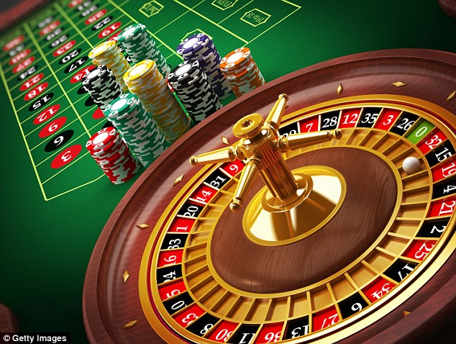
Proof of Work
Miners buy lottery tickets …
Winner gets to choose next block …
Winner is paid only if other miners accept that block
Notes:
There are many ways to explain how proof-of-work consensus works. For our purposes, we don’t care at all about details, so we will just say that each miner repeatedly buys a lotter ticked. If that ticket wins, the miner gets to append the next block. If that block is accepted by enough other miners, the winner collects a reward, so the winner is incentivized to be honest and only add blocks that belong on the ledger. Obviously, the full story is way more complex, but this simplification will serve us for the time being

Slide 67
Miners add new blocks
Buy a lottery ticket
Buy a lottery ticket
Buy a lottery ticket
Buy a lottery ticket
Buy a lottery ticket
Buy a lottery ticket
Notes:
Here, the miners repeatedly buy lottery tickets, hoping to find a winning ticket that will allow them to collect a reward by appending an honest block to the chain

Slide 68
Winning is random
I won!
Notes:
Here the blue miner found a winning ticket …

Slide 69
Winning miner adds new block
Notes:
So that miner appeds a new (red) block to the chain. At first only the blue miner knows it has won the lottery, and only the blue miner knows of the new blocks.

Slide 70
New block propagates
Notes:
News of the new block propagates through the network. Propagating data through the network takes time, and we have a pretty good idea how long it takes for the news to reach all the other miners.

Slide 71
What could go wrong?
I won!
So did I!
Notes:
Here’s a problem. Lottery tickets are independent of one another, it is possible that two miners win the lottery at about the same time.

Slide 72
Competing New Blocks
Notes:
Each of these miners appends a new block, and each one expects a reward.

Slide 73
The Chain is forked!
Notes:
This is a problem, because the blockchain is supposed to be a chain, not a tree, and most such protocols can’t make sense of parallel blocks.

Slide 74
Eventually one branch prevails, other is orphaned
Orphans mean wasted work, slower finality
Notes:
The way Bitcoin and other PoW protocols deal with forking is see which blocks are accepted by other miners. Eventually other miners will build on one block or another, and the block with the most weight (the most votes of confidence from the miners) prevails and the other block becomes an orphan, meaning it is ignored, and its creator collects no rewards. Orphans are bad because the represent wasted work by the miner who created the block, and a missed opportunity to incorporate that block’s transactions in the chain.

Slide 75
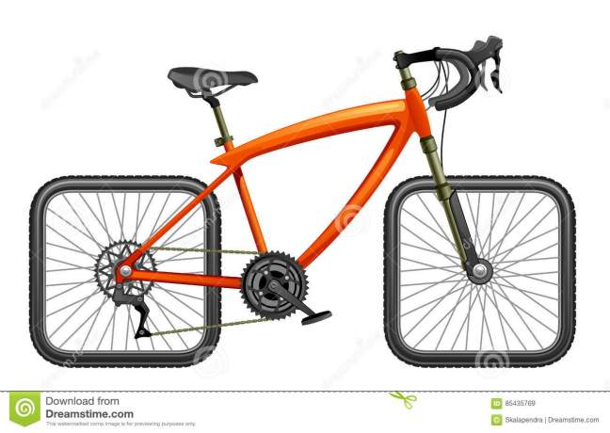
PoW rate-limits itself
Bitcoin (& ilk) deliberately slow block rate
Frequent blocks, frequent forks
Limits scalability
Needed: PoW protocol that does not self-limit
Notes:
Because forking is expensive, the Bitcoin protocol throttles itself, in the sense that it deliberately prevents itself from producing blocks too quickly. This imposes a hard limit on PoW scalability:: if the block rate is too high, there is too much forking, resulting in wasted computation and delayed finality, and it is too low, well, then the chain is slow.

Slide 76
Kicking out the jams?
genesis
If we dial up the block rate (to 11?) the chain becomes a tree
Notes:
What would happen if we make the lottery easier and just let the Bitcoin protocol run at full speed? We are creating blocks faster than we can propagate them, so we end up with a tree structure like this, where there are many blocks, which is good, but many of those blocks do not know about other blocks, which is bad.

Slide 77
Embrace the chaos
genesis
Make new blocks reference all known predecessors
Notes:
Because we want to propagate as much information as possible, let’s have blocks reference all their know predecessors instead of selecting a single predecessor. The result is no longer a tree --- it is a directed acyclic graph, or DAG. Directed means links are always directed (to the past), acyclic means you can’t move in a circle (no time travel), and a graph of course is anything with boxes linked by lines.

Slide 78
Embrace the chaos
I am honest
We don’t know about each other
genesis
Because we were created at about the same time!
I am honest
Notes:
We say a block is honest if it was created by an honest miner. Two honest blocks can be unconnected only if they are created at approximately the same time.

Slide 79
Embrace the chaos
There are at most k blocks unknown to me
genesis
Notes:
If we know the block propagation delay, then we can put a limit k on the number of blocks likely to be unconnected to an honest block. Of course, an attacker can create any blocks structure it wants, but remember that attackers have less than half the computational power (the lottery tickets).

Slide 80
Which k?
k = 0
k = 3
Notes:
The ledger can choose a value of k based on the network propagation delay and other factors. If k is zero, then the DAG becomes a classical chain. If k is 3, the DAG might look like this

Slide 81
Double Spending Attempted
Alice pays Bob
genesis
Alice pays Carol
Notes:
What can we do about conflicting transactions? Here Alice is attempting to double-spend her coin by placing conflicting transactions on blocks that do not know about each other .

Slide 82
Double Spending Foiled by (eventual) total ordering
Alice pays Carol
Alice pays Bob
invalid
genesis
Notes:
The miners eventually reach consensus on a way to order all honest blocks consistent with the DAG order. If there is a double spend, for example, the earlier transaction is executed, and the later one is discarded. We will explain shortly how the miners agree on this order.

Slide 83
Present, Past, Future
Future cone
future
future
block
future
future
Notes:
Remember that arrows go back in time: the later block points to the earlier back. Each block B divides the chain into three parts: the blocks referenced by B, directly or idirectly, constitute B’s past – these are the blocks that B’s creator saw when it added B to the chain. The blocks that reference B, directly or indirectly, represent B’s future: these blocks will be influenced by B. Borrowing some terms from physics, B’s past and future are called its cone. The blocks that are neither in B’s past nor its future are called its anticone. If B is honest, we know the size of its anticone is unlikely to exceed k.

Slide 84
Present, Past, Future
Future cone
Past cone
future
past
future
block
past
past
future
future
Notes:
Remember that arrows go back in time: the later block points to the earlier back. Each block B divides the chain into three parts: the blocks referenced by B, directly or idirectly, constitute B’s past – these are the blocks that B’s creator saw when it added B to the chain. The blocks that reference B, directly or indirectly, represent B’s future: these blocks will be influenced by B. Borrowing some terms from physics, B’s past and future are called its cone. The blocks that are neither in B’s past nor its future are called its anticone. If B is honest, we know the size of its anticone is unlikely to exceed k.

Slide 85
Present, Past, Future
Future cone
Past cone
future
past
future
block
past
past
future
future
Anticone
Notes:
Remember that arrows go back in time: the later block points to the earlier back. Each block B divides the chain into three parts: the blocks referenced by B, directly or idirectly, constitute B’s past – these are the blocks that B’s creator saw when it added B to the chain. The blocks that reference B, directly or indirectly, represent B’s future: these blocks will be influenced by B. Borrowing some terms from physics, B’s past and future are called its cone. The blocks that are neither in B’s past nor its future are called its anticone. If B is honest, we know the size of its anticone is unlikely to exceed k.

Slide 86
Phantom
Recognizes honest blocks, discounts the rest
Honest blocks are well-connected!
Honest block, time t, network delay D
Past cone: all blocks before t-D
Future cone: all blocks after t+D
Anticone: at most k blocks
Notes:
The PHANTOM protocol’s goal is to recognize the honest blocks, and to discard or penalize the rest. The principal insight is that the honest blocks are well connected: if it takes D time for a block to traverse the network of miners, then an honest block will reference every honest block created before time t-D, and that block will be referenced by every honest block created after t+D. An honest block can be disconnected from only about k blocks at most. The attacker creating dishonest blocks that conflict with the honest blocks will have to work in isolation, disconnected from much of the DAG.

Slide 87
k-clusters
genesis
Notes:
A k-cluster is a subset of blocks such that every block in the cluster is connected to all but at most k blocks in the cluster. The honest blocks most likely form a k-cluster. The dishonest blocks may form a k-cluster, but it will be smaller.

Slide 88
Phantom Algorithm
genesis
Notes:
Now we are ready to present the PHANTOM algorithm.

Slide 89
Phantom Algorithm
genesis
Step 1: Find the largest k-cluster
Notes:
The first step is to find the largest k-cluster in the DAG.

Slide 90
Phantom Algorithm
genesis
Step 2: Order those blocks
Notes:
The second step is to sort the blocks in that cluster in an order compatible with the DAG order.

Slide 91
Phantom Algorithm
Alice pays Carol
Alice pays Bob
invalid
genesis
Step 3: walk chain, discard invalid txns
Notes:
A k-cluster is a subset of blocks such that every block in the cluster is connected to all but at most k blocks in the cluster. The honest blocks most likely form a k-cluster. The dishonest blocks may form a k-cluster, but it will be smaller.

Slide 92
Theorem
If attacker has < ½ the computational power,
Then under any load,
The largest k-cluster is all honest,
For suitable k.
Notes:
If attacker has less than half the computational power, then under any load, the largest k-cluster was created by honest miners, for suitable k. So this protocol does what we want.

Slide 93
Not so fast!
Finding max k-cluster is NP-hard
Meaning: don’t even try
But we don’t need the largest cluster …
A pretty large cluster will do
Notes:
Unfortunately, the PHANTOM protocol is NP-hard, which means that no one knows how to solve it efficiently, and if you figured out a way to do that, you could also have efficient solutions to lots of other problems that no believes has efficient solutions, so we had better back off and try something else. Instead, we don’t really need to find the largest possible cluster, we will be fine if we can efficiently find a pretty large cluster.

Slide 94
k-Uncles
O-uncle
genesis
2-uncle
1-uncle
3-uncle
Notes:
A k-uncle of a chain is a block unconnected (in past or future) to at most k blocks in that chain. Here are some examples ….

Slide 95
GHOSTDAG Protocol
Find the chain with the most k-uncles
Order those blocks in a DAG-consistent way
Walk resulting chain, discarding invalid txns
Notes:
The GHOSTDAG protocol is the same as the PHANTOM protocol, except it replaces the NP-hard first step (find the largest k-cluster) with a greedy approximation: look at all the linear chains, find the one with the most k-uncles, and construct a k-cluster from that chain and its uncles.

Slide 96
Theorem
If attacker has < ½ the computational power,
(Almost) all honest blocks are uncles of degree ≤ k of heaviest chain
(Almost) no dishonest blocks are uncles of degree ≤ k of heaviest chain
Everyone eventually agrees on order over honest blocks
Notes:
This theorem (proved in the paper) states that the cluster we assembled is highly likely to include almost all honest blocks, and almost no dishonest blocks. Moreover, all miners eventually agree on a stable (total) order on all the blocks included in the DAG. So this protocol does what we want.

Slide 97
Remarks
Protocol itself does not self-limit throughput
Simple, efficient (open source)
Deployed:
Kaspa = GhostDAG + UTXO
Coming soon:
BlockDAG = GhostDAG + UTXO + EVM
Notes:
Walk through example (15:00)

Slide 98
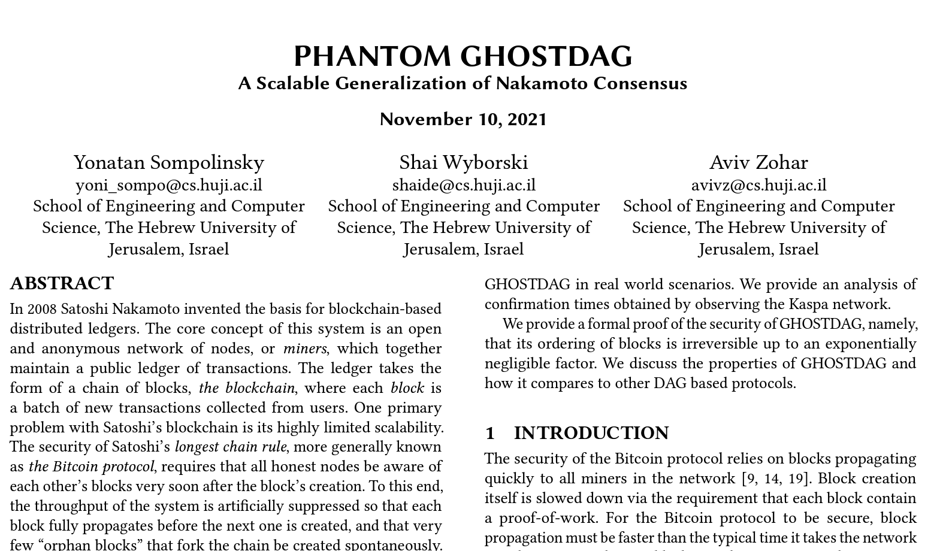
To Dig Deeper
Notes:
This is a talk about the consensus protocol at the heart of BlockDAG. I am going to talk about the algorithm, how it works and what it accomplishes. I am not going to talk about BlockDAG’s implementation of the algorithm, because that would be an entirely different talk. I am going to try to describe this algorithm in elementary terms, accessible to a general audience, so I apologize to those of you who are familiar with these kinds of algorithms. The work I am describing here is not mine: it is due to the authors of this paper, and I encourage you to go read the paper for more technical detail.

Slide 99
A Blockchain is just a distributed ledger
Append-only list of events
Not just financial
Everyone agrees on content
Tamper-proof!
Notes:
A blockchain is just one way to implement a distributed ledger. Ledgers were invented by Italian renaissance bankers to keep track of their assets. A Ledger is just a list of things that happened. The list is append-only: once you write an entry, you cannot go back to delete or modify it. If you make a mistake, you can append a correction, but you cannot cover up the past. We usually think of ledgers as recording financial data, but a ledger could hold anything: a database log, a ship’s log, or a list of today’s visitors. The important thing is that all parties agree on the ledger’s meaning. Above all, the ledger is tamper-proof.

Slide 100
Literally …
This happened
This happened
This happened
Notes:
A blockchain is just a list of things that happened, listed in the order they happened. We will call these things blocks,a nd they typically hold multiple transactions, though this level of detail is not important here. Note that arrows go backwards in time: later blocks point to earlier blocks. In addition, hashing is used to make sure that any tampering will be detected.

Slide 101
Miners add new blocks
Notes:
Who decides which entries make it onto the ledger? In proof of work protocols, the kind we are concerned with here, parties called miners decide. Each miner has its own copy of the chain, and acts as gatekeeper for adding new blocks.

Slide 102
Proof of Work
Miners buy lottery tickets …
Winner gets to choose next block …
Winner is paid only if other miners accept that block
Notes:
There are many ways to explain how proof-of-work consensus works. For our purposes, we don’t care at all about details, so we will just say that each miner repeatedly buys a lotter ticked. If that ticket wins, the miner gets to append the next block. If that block is accepted by enough other miners, the winner collects a reward, so the winner is incentivized to be honest and only add blocks that belong on the ledger. Obviously, the full story is way more complex, but this simplification will serve us for the time being

Slide 103
Miners add new blocks
Buy a lottery ticket
Buy a lottery ticket
Buy a lottery ticket
Buy a lottery ticket
Buy a lottery ticket
Buy a lottery ticket
Notes:
Here, the miners repeatedly buy lottery tickets, hoping to find a winning ticket that will allow them to collect a reward by appending an honest block to the chain

Slide 104
Winning is random
I won!
Notes:
Here the blue miner found a winning ticket …

Slide 105
Winning miner adds new block
Notes:
So that miner appeds a new (red) block to the chain. At first only the blue miner knows it has won the lottery, and only the blue miner knows of the new blocks.

Slide 106
New block propagates
Notes:
News of the new block propagates through the network. Propagating data through the network takes time, and we have a pretty good idea how long it takes for the news to reach all the other miners.

Slide 107
What could go wrong?
I won!
So did I!
Notes:
Here’s a problem. Lottery tickets are independent of one another, it is possible that two miners win the lottery at about the same time.

Slide 108
Competing New Blocks
Notes:
Each of these miners appends a new block, and each one expects a reward.

Slide 109
The Chain is forked!
Notes:
This is a problem, because the blockchain is supposed to be a chain, not a tree, and most such protocols can’t make sense of parallel blocks.

Slide 110
Eventually one branch prevails, other is orphaned
Orphans mean wasted work, slower finality
Notes:
The way Bitcoin and other PoW protocols deal with forking is see which blocks are accepted by other miners. Eventually other miners will build on one block or another, and the block with the most weight (the most votes of confidence from the miners) prevails and the other block becomes an orphan, meaning it is ignored, and its creator collects no rewards. Orphans are bad because the represent wasted work by the miner who created the block, and a missed opportunity to incorporate that block’s transactions in the chain.

Slide 111
PoW rate-limits itself
Bitcoin (& ilk) deliberately slow block rate
Frequent blocks, frequent forks
Limits scalability
Needed: PoW protocol that does not self-limit
Notes:
Because forking is expensive, the Bitcoin protocol throttles itself, in the sense that it deliberately prevents itself from producing blocks too quickly. This imposes a hard limit on PoW scalability:: if the block rate is too high, there is too much forking, resulting in wasted computation and delayed finality, and it is too low, well, then the chain is slow.

Slide 112
Kicking out the jams?
genesis
If we dial up the block rate (to 11?) the chain becomes a tree
Notes:
What would happen if we make the lottery easier and just let the Bitcoin protocol run at full speed? We are creating blocks faster than we can propagate them, so we end up with a tree structure like this, where there are many blocks, which is good, but many of those blocks do not know about other blocks, which is bad.

Slide 113
Embrace the chaos
genesis
Make new blocks reference all known predecessors
Notes:
Because we want to propagate as much information as possible, let’s have blocks reference all their know predecessors instead of selecting a single predecessor. The result is no longer a tree --- it is a directed acyclic graph, or DAG. Directed means links are always directed (to the past), acyclic means you can’t move in a circle (no time travel), and a graph of course is anything with boxes linked by lines.

Slide 114
Embrace the chaos
I am honest
We don’t know about each other
genesis
Because we were created at about the same time!
I am honest
Notes:
We say a block is honest if it was created by an honest miner. Two honest blocks can be unconnected only if they are created at approximately the same time.

Slide 115
Embrace the chaos
There are at most k blocks unknown to me
genesis
Notes:
If we know the block propagation delay, then we can put a limit k on the number of blocks likely to be unconnected to an honest block. Of course, an attacker can create any blocks structure it wants, but remember that attackers have less than half the computational power (the lottery tickets).

Slide 116
Which k?
k = 0
k = 3
Notes:
The ledger can choose a value of k based on the network propagation delay and other factors. If k is zero, then the DAG becomes a classical chain. If k is 3, the DAG might look like this

Slide 117
Double Spending Attempted
Alice pays Bob
genesis
Alice pays Carol
Notes:
What can we do about conflicting transactions? Here Alice is attempting to double-spend her coin by placing conflicting transactions on blocks that do not know about each other .

Slide 118
Double Spending Foiled by (eventual) total ordering
Alice pays Carol
Alice pays Bob
invalid
genesis
Notes:
The miners eventually reach consensus on a way to order all honest blocks consistent with the DAG order. If there is a double spend, for example, the earlier transaction is executed, and the later one is discarded. We will explain shortly how the miners agree on this order.

Slide 119
Present, Past, Future
Future cone
future
future
block
future
future
Notes:
Remember that arrows go back in time: the later block points to the earlier back. Each block B divides the chain into three parts: the blocks referenced by B, directly or idirectly, constitute B’s past – these are the blocks that B’s creator saw when it added B to the chain. The blocks that reference B, directly or indirectly, represent B’s future: these blocks will be influenced by B. Borrowing some terms from physics, B’s past and future are called its cone. The blocks that are neither in B’s past nor its future are called its anticone. If B is honest, we know the size of its anticone is unlikely to exceed k.

Slide 120
Present, Past, Future
Future cone
Past cone
future
past
future
block
past
past
future
future
Notes:
Remember that arrows go back in time: the later block points to the earlier back. Each block B divides the chain into three parts: the blocks referenced by B, directly or idirectly, constitute B’s past – these are the blocks that B’s creator saw when it added B to the chain. The blocks that reference B, directly or indirectly, represent B’s future: these blocks will be influenced by B. Borrowing some terms from physics, B’s past and future are called its cone. The blocks that are neither in B’s past nor its future are called its anticone. If B is honest, we know the size of its anticone is unlikely to exceed k.

Slide 121
Present, Past, Future
Future cone
Past cone
future
past
future
block
past
past
future
future
Anticone
Notes:
Remember that arrows go back in time: the later block points to the earlier back. Each block B divides the chain into three parts: the blocks referenced by B, directly or idirectly, constitute B’s past – these are the blocks that B’s creator saw when it added B to the chain. The blocks that reference B, directly or indirectly, represent B’s future: these blocks will be influenced by B. Borrowing some terms from physics, B’s past and future are called its cone. The blocks that are neither in B’s past nor its future are called its anticone. If B is honest, we know the size of its anticone is unlikely to exceed k.

Slide 122
Phantom
Recognizes honest blocks, discounts the rest
Honest blocks are well-connected!
Honest block, time t, network delay D
Past cone: all blocks before t-D
Future cone: all blocks after t+D
Anticone: at most k blocks
Notes:
The PHANTOM protocol’s goal is to recognize the honest blocks, and to discard or penalize the rest. The principal insight is that the honest blocks are well connected: if it takes D time for a block to traverse the network of miners, then an honest block will reference every honest block created before time t-D, and that block will be referenced by every honest block created after t+D. An honest block can be disconnected from only about k blocks at most. The attacker creating dishonest blocks that conflict with the honest blocks will have to work in isolation, disconnected from much of the DAG.

Slide 123
k-clusters
genesis
Notes:
A k-cluster is a subset of blocks such that every block in the cluster is connected to all but at most k blocks in the cluster. The honest blocks most likely form a k-cluster. The dishonest blocks may form a k-cluster, but it will be smaller.

Slide 124
Phantom Algorithm
genesis
Notes:
Now we are ready to present the PHANTOM algorithm.

Slide 125
Phantom Algorithm
genesis
Step 1: Find the largest k-cluster
Notes:
The first step is to find the largest k-cluster in the DAG.

Slide 126
Phantom Algorithm
genesis
Step 2: Order those blocks
Notes:
The second step is to sort the blocks in that cluster in an order compatible with the DAG order.

Slide 127
Phantom Algorithm
Alice pays Carol
Alice pays Bob
invalid
genesis
Step 3: walk chain, discard invalid txns
Notes:
A k-cluster is a subset of blocks such that every block in the cluster is connected to all but at most k blocks in the cluster. The honest blocks most likely form a k-cluster. The dishonest blocks may form a k-cluster, but it will be smaller.

Slide 128
Theorem
If attacker has < ½ the computational power,
Then under any load,
The largest k-cluster is all honest,
For suitable k.
Notes:
If attacker has less than half the computational power, then under any load, the largest k-cluster was created by honest miners, for suitable k. So this protocol does what we want.

Slide 129
Not so fast!
Finding max k-cluster is NP-hard
Meaning: don’t even try
But we don’t need the largest cluster …
A pretty large cluster will do
Notes:
Unfortunately, the PHANTOM protocol is NP-hard, which means that no one knows how to solve it efficiently, and if you figured out a way to do that, you could also have efficient solutions to lots of other problems that no believes has efficient solutions, so we had better back off and try something else. Instead, we don’t really need to find the largest possible cluster, we will be fine if we can efficiently find a pretty large cluster.

Slide 130
k-Uncles
O-uncle
genesis
2-uncle
1-uncle
3-uncle
Notes:
A k-uncle of a chain is a block unconnected (in past or future) to at most k blocks in that chain. Here are some examples ….

Slide 131
GHOSTDAG Protocol
Find the chain with the most k-uncles
Order those blocks in a DAG-consistent way
Walk resulting chain, discarding invalid txns
Notes:
The GHOSTDAG protocol is the same as the PHANTOM protocol, except it replaces the NP-hard first step (find the largest k-cluster) with a greedy approximation: look at all the linear chains, find the one with the most k-uncles, and construct a k-cluster from that chain and its uncles.

Slide 132
Theorem
If attacker has < ½ the computational power,
(Almost) all honest blocks are uncles of degree ≤ k of heaviest chain
(Almost) no dishonest blocks are uncles of degree ≤ k of heaviest chain
Everyone eventually agrees on order over honest blocks
Notes:
This theorem (proved in the paper) states that the cluster we assembled is highly likely to include almost all honest blocks, and almost no dishonest blocks. Moreover, all miners eventually agree on a stable (total) order on all the blocks included in the DAG. So this protocol does what we want.

Slide 133
Remarks
Protocol itself does not self-limit throughput
Simple, efficient (open source)
Deployed:
Kaspa = GhostDAG + UTXO
Coming soon:
BlockDAG = GhostDAG + UTXO + EVM
Notes:
Walk through example (15:00)

Slide 134
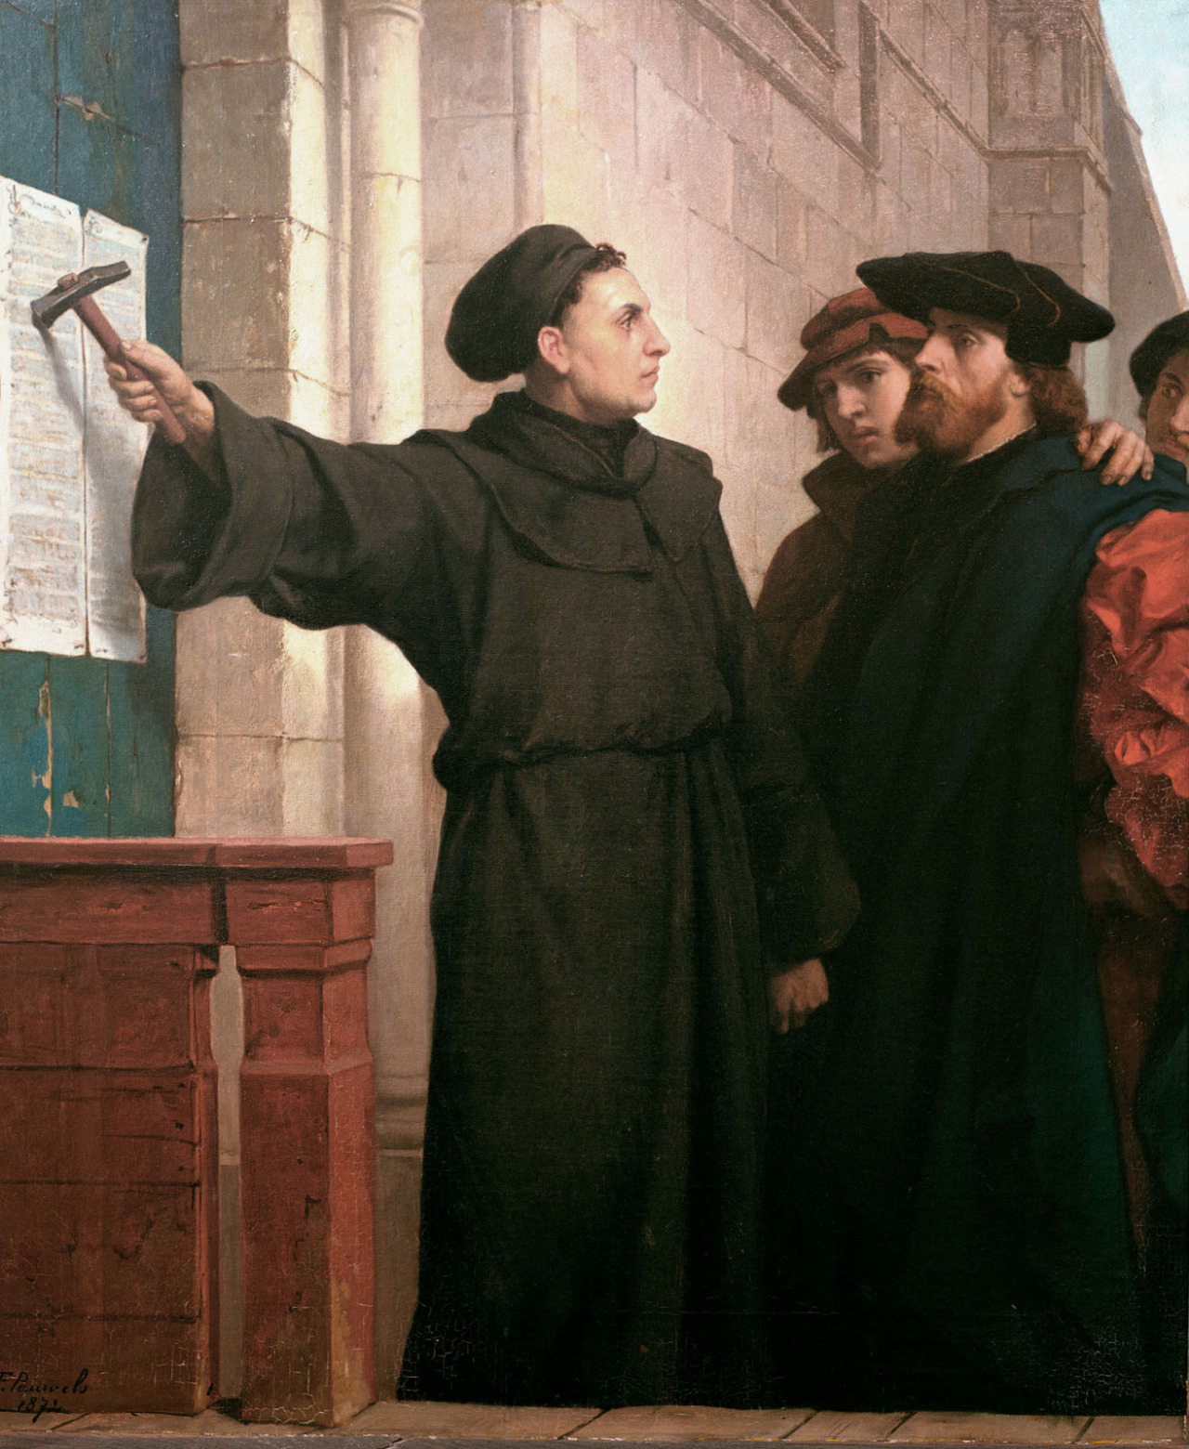
Ideas we covered in this lecture
Consensus in Byzantine models
Semi-Synchronous models
HotStuff Protocol
PHANTOM and blockDAGs

